Slide 1
NPRE 321 Introduction to Plasmas and their Applications
Research Associate Professor Daniel Andruczyk
Hybrid Illinois Device for Research and Applications
Center for Plasma Materials Interactions
Department of Nuclear, Plasma and Radiological Engineering
University of Illinois Urbana-Champaign
3 Hours of Lectures per week
Including Practicums

Slide 2
LECTURE 08
PRACTICUM I
Describing a Basic Plasma Discharge

Slide 3
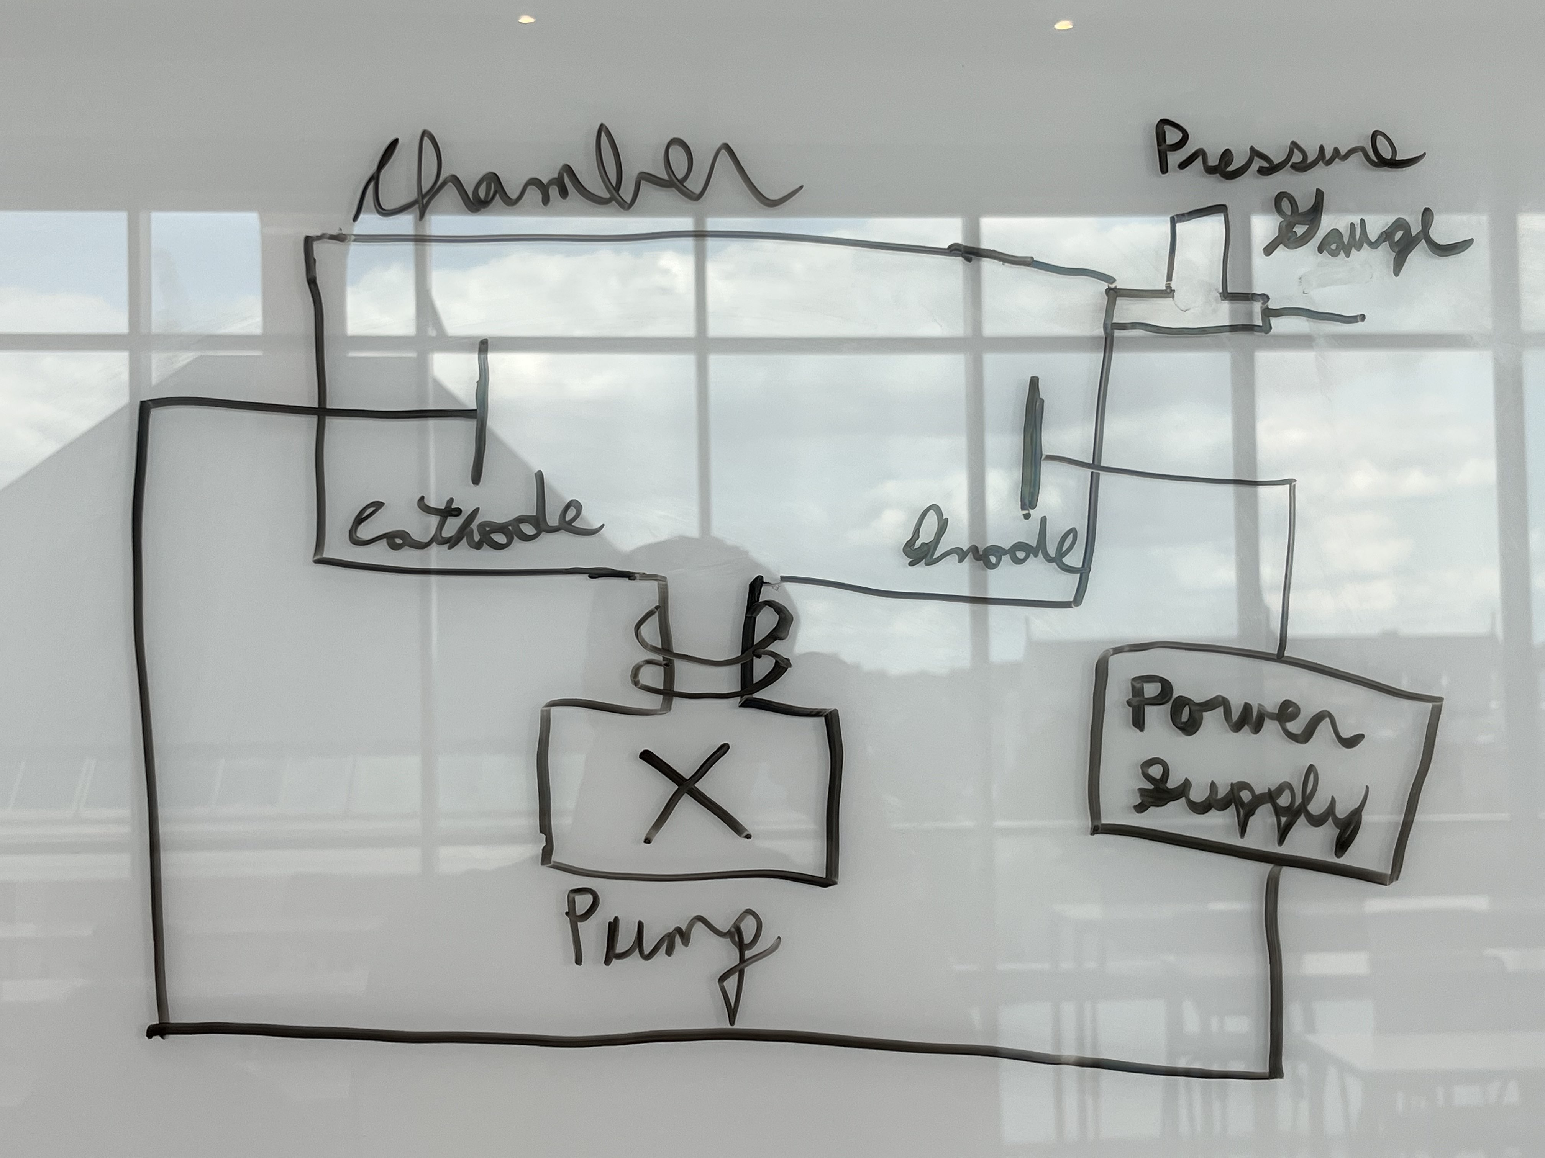
Practicum Laboratory #1: DESCRIBING A BASIC PLASMA DISCHARGE Student Name: Joseph Specht (jspecht3) Practicum Date: 9/8/2023
Introduction: (Description of the apparatus and experiment being shown)
The apparatus was mainly comprised of a vacuum chamber where the atmosphere was pumped out to near vacuum and then an argon gas was let into the chamber. On opposite ends of inside the chamber, there was a cathode and anode connected to a power supply outside of the chamber. The final component of this circuit was the pressure gauge, which was used to modulate the plasma.
The experiment started with increasing the voltage of the power supply until it ionized the argon gas and subsequently generated a plasma inside the vessel. The types of plasma that were observed would be normal glow, diffuse glow, and arc glow.
The normal glow would be the first plasma to be seen and it is very apparent when the modes transition from a Townsend discharge to a normal glow plasma as the inside of the chamber will brightly light up. However, there will be a small dark spot inside the plasma.
The diffuse glow occurs after the voltage has been reduced on the normal glow as starting a normal glow requires a certain voltage defined by a work function, which the voltage to maintain a plasma is lower than. This results in a plasma that is not as bright as the normal glow and only appears to be glowing slightly. The dark spot in the middle of the plasma will also be larger.
The arc glow occurs when the voltage is massively increased, and the plasma gets confined into a narrow arc that much resembles lighting. This plasma is very bright inside the arc, but invisible outside of the arc.

Slide 4
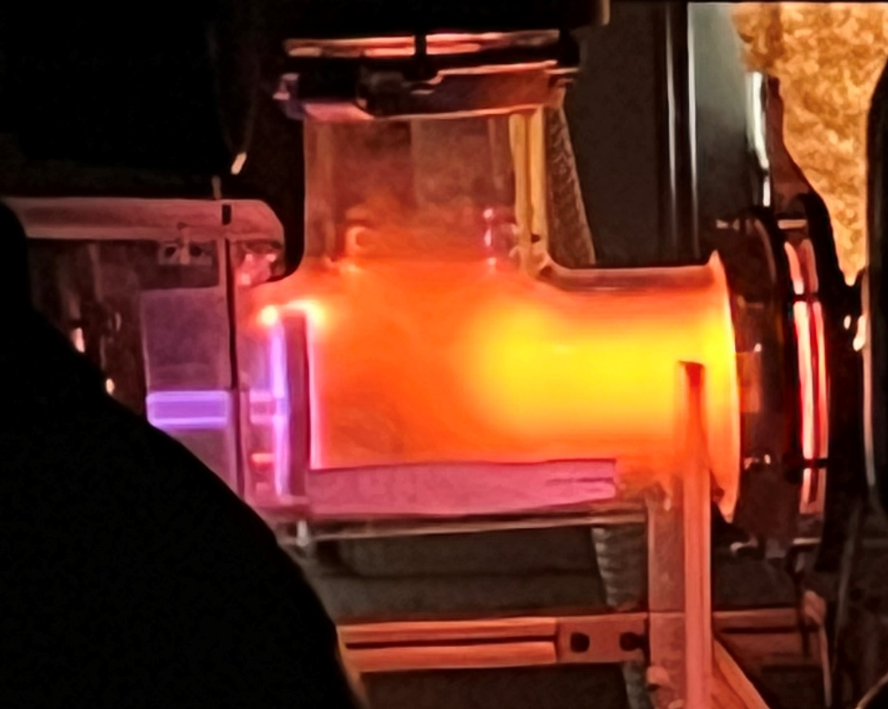
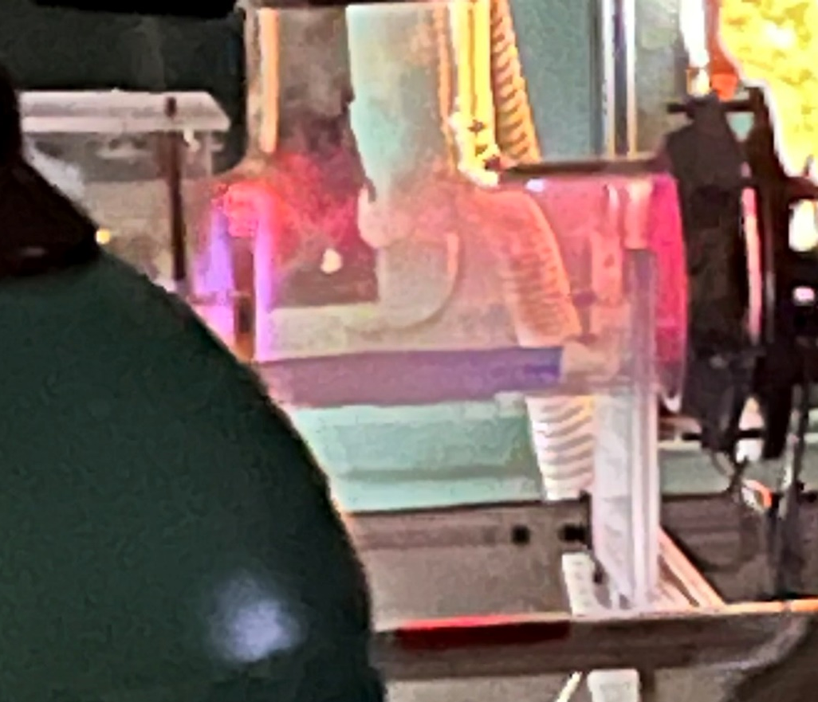
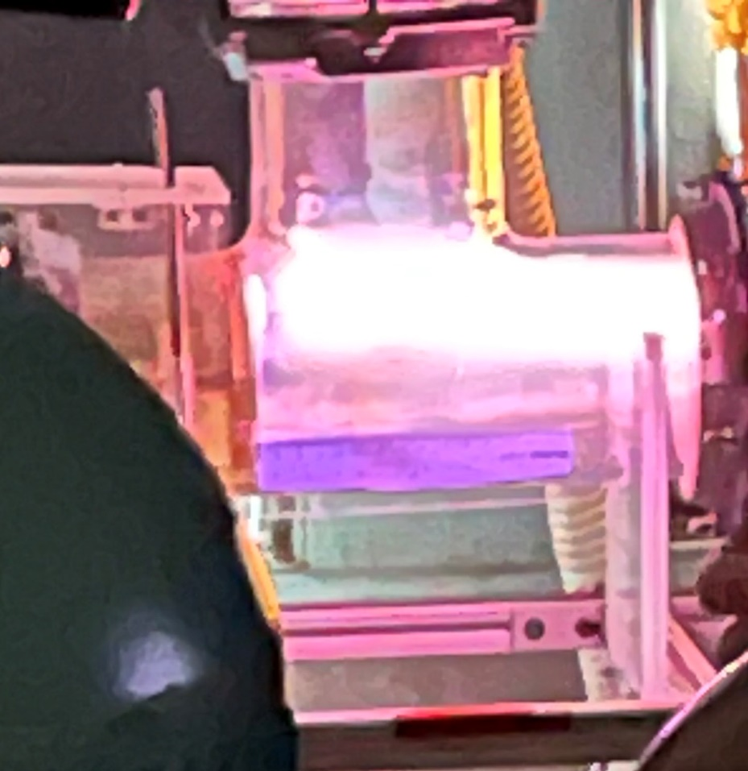
Observations: (Describe what you saw in the laboratory today, describe equipment and other aspects, include diagrams)
In this experiment, the first plasma that was observed was a normal glow plasma. This plasma is characterized as a full-body glow……………………………. glow where the main body of the plasma emits a bright orange glow. This is the first type of plasma observed because this is the type…………………………….. type of plasma generated as soon as the work function was overcome. Pictured to the left is a normal glow plasma for argon.
The second type of plasma generated was the diffuse glow plasma, which is generated by decreasing the power supply’s voltage when a normal glow plasma has already been established. This is because the normal glow plasma requires a higher voltage to establish the plasma than to maintain the plasma. The consequence of this is pictured to the right where the plasma is diffusely glowing and the dark spot that was previously small in the normal glow plasma is now much more exaggerated and larger in the diffuse plasma.
The final plasma observed was the arc glow plasma, which was generated by increasing the voltage between the two terminals while a testing normal glow plasma was established. Pictured left is the arc glow plasma, which looks like lightning in real life, but a bright streak in testing the picture. This plasma is due the voltage being high enough to arc between the terminals through air. This differs from before as the testing normal or diffuse glows did not have enough energy to arc from terminal to terminal, so the plasma was generated with relatively testing-testing uncommon chain reaction events all over the chamber.

Slide 5

Observations (continued):
Aside from the main plasma, there was also a plasma sheath generated around the anode due to higher excitation states of the electrons. This comes form a multiply ionized argon atom, which gives off a higher energy photon that is blue in contract to the orange of the bulk plasma.
A final observation was that the plasma responded to a magnetic field by increasing in density for both types of glow and bending the arc plasma towards the magnet. The magnet curves the plasma because plasma is a quasi-neutral, so, although it appears neutral globally, it is subject to magnetic fields locally and would oscillate around an equilibrium if a strong enough magnetic field was present.

Slide 6
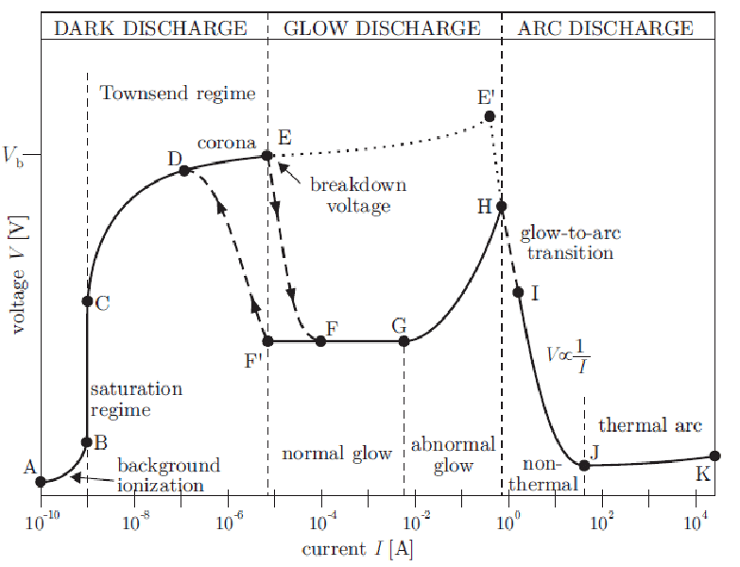
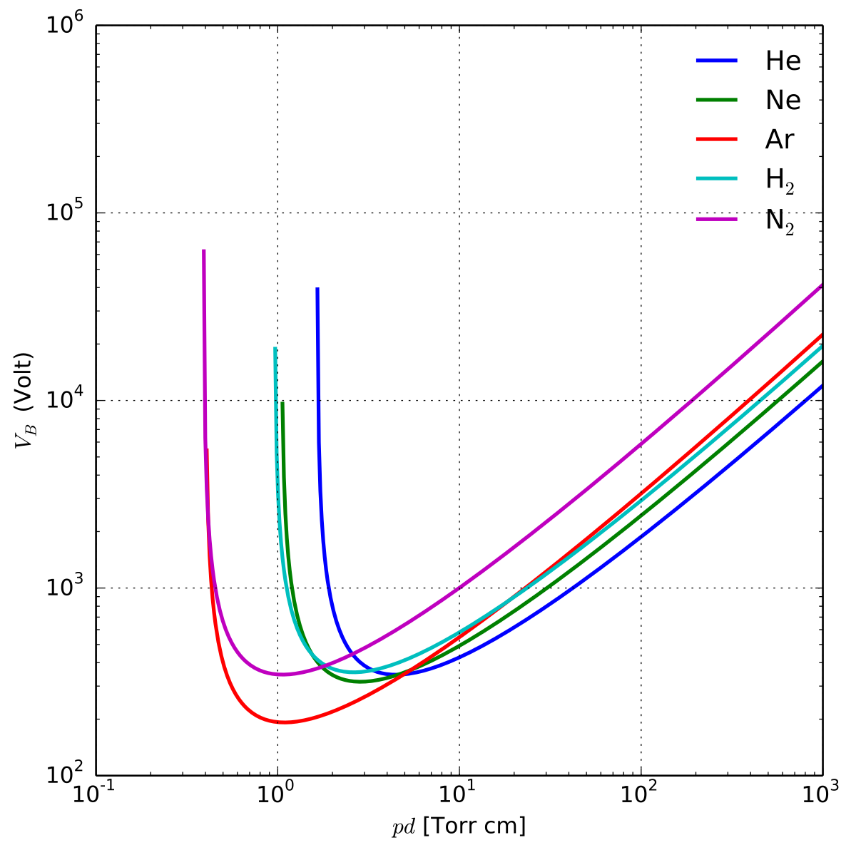
Discussion: (Discuss the results that were shown today, include any analysis)
The types of plasma observed were diffuse glow, normal glow, and arc discharge. As can be seen by the figure to the right, once the breakdown voltage is reached, normal glow begins to happen. This is exactly what happened in the experiment the plasma suddenly became visible as the voltage was increased.
The diffuse glow is also in accordance with the figure to the left as there is a path to a lower voltage once the breakdown voltage occurs. The diffuse glow followed this path to a lower voltage and, subsequently, had less electron excitations than the normal glow, which caused a dimmer glow.
Finally, we observed the arc discharge, which happens when the voltage is increased enough to turn the normal glow plasma into a narrow, confined arc. This arc is where the most visible change occurs under the influence of a magnet. This contrasts with the normal and diffuse glows where the addition of a magnetic field would only change the density of the plasma and not the overall shape. However, in the arc discharge, the density of the plasma is not the main observable change, but the path the arc took as it is the easiest way to mitigate the magnetic field.
Something that has not been discussed so far is the effect pressure had. The Paschen curve (pictured left) shows the required voltage to generate a plasma at a given pressure. The main change in this experiment was the voltage, but the pressure was also changed to show the effects. When the pressure was increased or decreased substantially, the plasma dissipated, so this would indicate the experiment was somewhere near the bottom of the curve.

Slide 7
Summary: (Summarize what the laboratory was about and how it ties into lectures)
The laboratory was mainly a demonstration of the types of discharge and how to generate them. Normal glow occurs whenever you pass the breakdown voltage for the given pressure, diffuse glow happens when you decrease the voltage after attaining a normal glow, and arc discharge happens when you increase the voltage on a normal glow. These plasma were then subjected to a magnetic field, which demonstrates the fact the there are two separate and oppositely charged substances, being the electrons and ions, inside the plasma and showing quasi-neutrality is truly what happens. This experiment also demonstrated an application of the Paschen curve when the pressure was substantially varied and caused the plasma to fall apart due the voltage being too low.

